Slide 1
Mailing Made Easy for Small Business
Intelligent Mail® for Small Business (IMsb) Tool
Notes:
Thank you for joining us on this call. Today we are going to review the Intelligent Mail for Small Business (IMsb) Tool to assist you with submitting your mailings electronically and as Full-Service.

Slide 2
Intelligent Mail® for Small Business Tool
®
The IMsb tool is a free, online tool specifically designed for small business mailers.
It’s a web-based program. No software or downloads required.
The Tool creates unique Intelligent Mail barcodes (IMb) for printing on address labels or mailpieces.
Full-Service electronic postage statements are automatically created.
Notes:
The IMsb Tool is a free, web-based tool. The Tool enables you to do the following:
Upload and validate an address list, eliminating undeliverable addresses.
Print addresses with unique Intelligent Mail barcodes on labels, directly on envelopes, or on inserts for window envelopes.
Create unique handling unit barcodes (tray or sack labels).
Create Full-Service electronic postage statements, which are automatically submitted to the acceptance unit.

Slide 3
Intelligent Mail® for Small Business Tool
®
Class of Mail: | First-Class Mail® USPS Marketing Mail®
Processing Category: | Cards Letters Flats
Size of Mailing: | Maximum mailing size: Fewer than 50,000 pieces per mailing. 250,000 annual piece limit has been removed
Addresses affixed to: | Labels (1-inch, 1.33-inch, 2-inch) Envelopes (No. 6¾, No. 7, No. 10) Inserts placed in window envelopes Mail Merge option
Permit Type: | Permit Imprint Precanceled Stamps Postage Meter
Notes:
The IMsb Tool can be used for:
First-Class Mail and USPS Marketing Mail, cards, letters, and flats.
Mailings may include up to 49,999 pieces. The 250,000 annual piece limit has been removed. The Tool will print on 3 sizes of Avery labels, directly on envelopes, or on an insert. There is also a mail merge option.
You have the option of using a permit imprint permit, precanceled stamps, or postage meter (active permit account required).

Slide 4
Customer Benefits
®
Using the IMsb Tool is FREE!
The Tool supports DSCF (Destination Sectional Center Facility) entry rates and all automation presort discounts along with the Full-Service discount.
The annual presort fee will be waived if all mailings are submitted as Full-Service!
Address list is cleansed:
Validates addresses within the database are accurate.
Reduces the amount undeliverable mail.
Ability to remove duplicates from your mailing lists.
Notes:
The Intelligent Mail for Small Business (IMsb) Tool is free!
IMsb Tool mailers receive both automation presort and Full-Service discounts.
The IMsb Tool supports all presort DSCF rates (where applicable).
IMsb Tool users may have their annual presort fee waived.
The IMsb Tool cleanses your address lists (removes undeliverable addresses).
You can remove duplicates from your address list.

Slide 5
Cost Comparison – Potential Savings
®
You submit USPS Marketing Mail letters at non-automation AADC/None price Yearly volume 250,000 x .346 per piece = $86,500.00
YOU SUBMIT THE SAME VOLUME USING IMSB TOOL:
Claiming Automation (AADC/None) 250,000 x .339 per piece = $84,750.00
Automation Savings $86,500.00 - $84,750.00 = $1750.00
Full-Service Discount 250,000 x .003 per piece = $750.00
(Seamless Incentive for qualifying Seamless EPS customers) 250,000 x .001 per piece = $250.00
Annual Presort Fee Waiver $290.00
Incentive Savings $ 1,290.00
TOTAL YEARLY SAVINGS $ 3,040.00
Notes:
Let’s do a cost comparison and look at the savings. If you submit a yearly volume of 250,000 pieces as STD Non-Auto letters claiming AADC none price, which is .346 per piece. The current postage is $86,500.00.
Using the IMsb tool, you will now benefit from “automation prices” (pieces have barcodes), which gives an instant .007 savings per piece on that AADC price (piece cost down to .339/pc); a $1750.00 savings.
Then you will receive the Full-Service discount of .003 per piece to get an additional savings of $750.00.
Once you begin using the tool, you can be on the road to potentially qualify for Seamless Acceptance to receive an incentive of .001 per piece if you also have an EPS account.
Permit Holders presenting Full-Service mailings are eligible for the annual presort mailing fees waiver, providing 75% or more of the permit’s overall volume is Full-Service Eligible, AND 90% or more of that volume Full-Service Eligible mail is submitted as Full-Service. So now we are talking about another savings of $290.00!
You have now saved over $3000.00/year just by using the IMsb Tool and submitting Full-Service mailings!
As a mailer, you can take advantage of all the different discounts and additional incentives being offered by the USPS for using eDoc submission. By keeping everything electronic, there is no need for a hard copy postage statement.

Slide 6
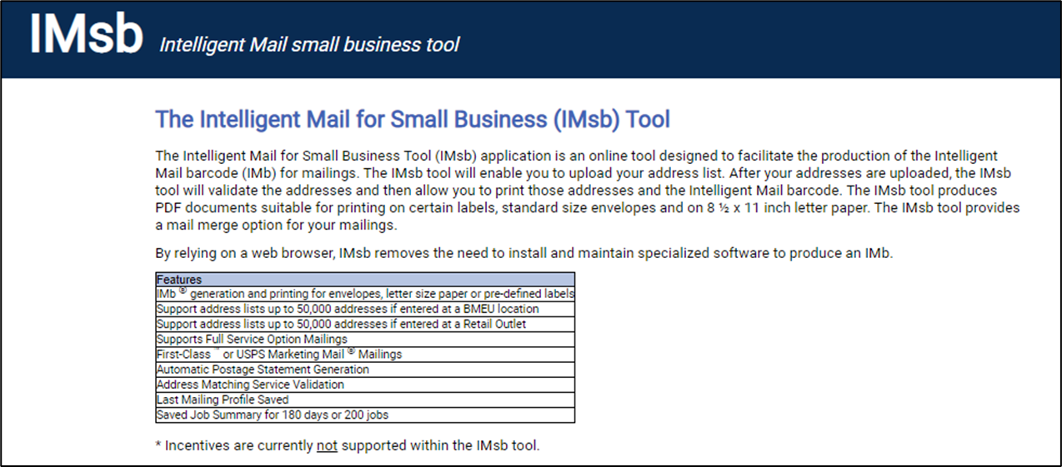
Electronic Postage Statements
®
The IMsb Tool walks you through entering all information needed to create an electronic postage statement and qualification report!
All mailing information is sent to PostalOne! electronically.
Notes:
IMsb Tool users no longer fill out and submit hard-copy postage statements. The IMsb Tool walks you through all the steps to create and submit a Full-Service electronic postage statement and qualification report, a requirement for all Full-Service mailings. There also is a step-by-step user guide.

Slide 7
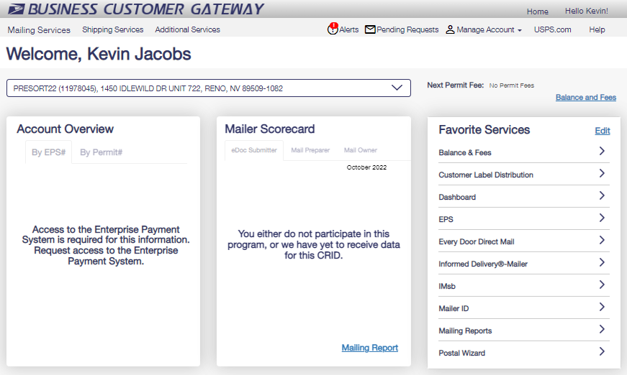
Access the IMsb Tool
®
No special software or installation is required to use the IMsb Tool.
Access the application via a web browser (e.g., Google Chrome, Microsoft Edge)
Log in through the IMsb link on the Business Customer Gateway® at gateway.usps.com
The IMsb Tool “Go to Service” link is located on the Mailing Services page. It can also be placed in your Favorite Services on the BCG Home page.
Notes:
There is no software download. In order to access the IMsb Tool, log in to your Business Customer Gateway (BCG) account and click on the “Intelligent Mail for Small Business Tool (IMsb)” link on the Mailing Services page.
As a reminder, you must have already linked your permit in the BCG.

Slide 8
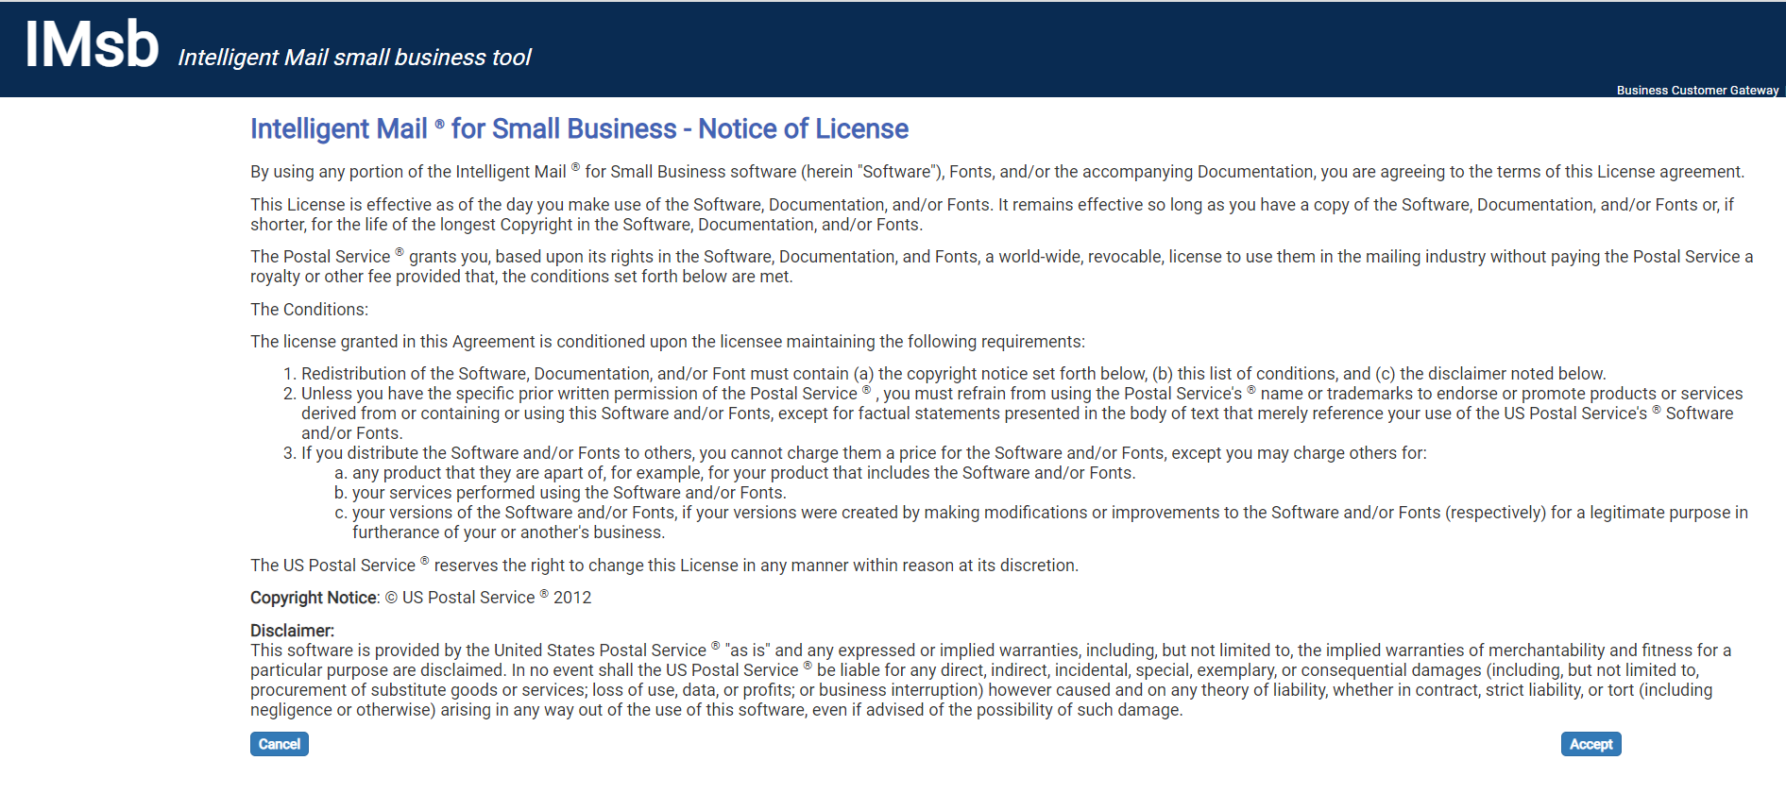
Notice of License change and Session Time Out indicator
®
Notes:
You must read and Accept the notice of license to proceed the first time you enter the IMsb Tool.
The second time and afterwards, this second screen will appear instead and takes you to the Job Details page.
As with the previous version of the IMsb tool, the session will close out after 15 minutes of inactivity. A new Time Out session warning will pop up at the 12-minute mark. This will allow you to reset the 15 minutes, so the session stays live and does not time out.

Slide 9
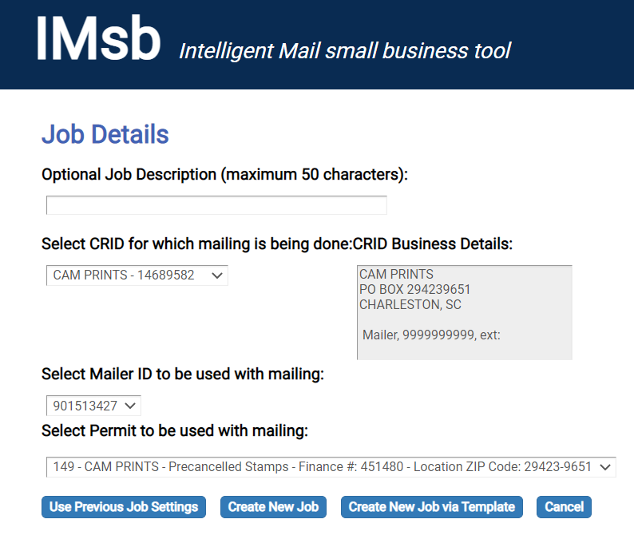
IMsb Job Creation & Mailer Information
®
The NEW landing page for the IMsb Tool
Step 1
Verify CRID and select permit to be used with the mailing.
Step 2
Click Create New Job.
Notes:
This is the new landing page for the IMsb Tool, where you will be able to use previous job settings, create a new job, create a new job via a template, or cancel.
Here you will see your information and if you have multiple CRIDs, MIDs, or Permits, you will be able to select them using the drop-down menus.
Select the permit to be used with the mailing.
Confirm the CRID and Permit selections are correct and click “Create New Job” to proceed.

Slide 10
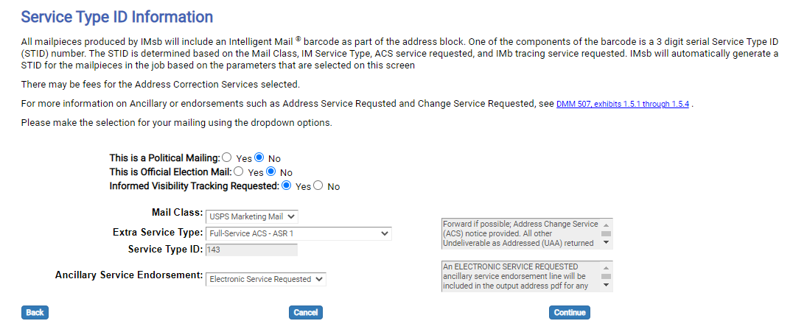
Service Type ID (STID) Information
®
Step 3
Political Mailing & Official Election Mail default to “No.”
Informed Visibility Tracking defaults to “Yes.”
Select:
Mail Class
Extra Service Type
How are you complying with Move Update?
Ancillary Service Endorsement
Selections will determine the STID for the mailing.
Click Continue to proceed.
Notes:
You must provide information pertinent to the mailing. The information here will help to create the correct data in the mailpiece barcodes. We are building the IMbs.
With the new enhancements, the Political and Election Mailing questions are on top of the first page, and they will default to No. We have also included an Informed Visibility Tracking Requested selection that will default to Yes.
Political Mailings and Official Election mailing indicators are defaulted to NO – You will need to choose yes for either of these that applies to your mailing.
IV Tracking - defaults to yes (no action needed).
Mail Class - First-Class Mail or USPS Marketing Mail (Nonprofit Mail is considered USPS Marketing Mail)
Extra Service Type - How do you wish to receive your address corrections back (if any). This is related to what Move Update Method you are planning to use; a Move Update method is a requirement to submit bulk mailings. It is a process to keep your mailing list up to date. You can use a premailing service (NCOA) or a post-mailing process – an ancillary service endorsement on mailpieces to redirect or notify you of COAs (a manual process) or Address change service, ACS (electronic ASE process). Select your appropriate service here. If you address your pieces with an alternative address format (or current resident), you will select NONE.
Service Type ID (STID)- This is a specific 3-digit code that will be embedded in the barcode specific to the class of mail and any additional handling. Each change to any of the above parameters will result in a different STID and can affect handling of undeliverable pieces.
Ancillary Service Endorsement - You must identify which endorsement will be printed on the mailpieces (if applicable). Options available will depend on the Extra Service Type selection.
Review selections and click Continue to proceed.

Slide 11
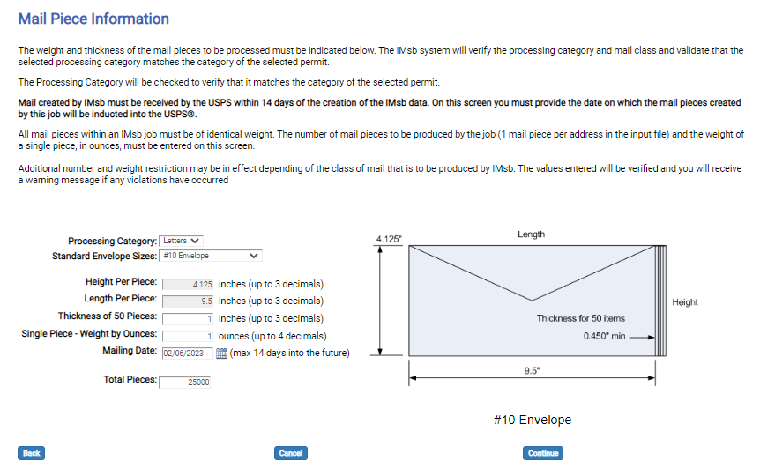
Mailpiece Information
®
Step 4
Enter the mail piece information:
Processing Category
Size of mailpiece
Thickness of 50 pieces stacked
Single piece weight in ounces
Date expected to present the mail at the BMEU
Approx. # of total pieces
Click Continue to proceed.
Notes:
You must provide information pertinent to the mailpiece.
Processing Category – Letters (cards) or Flats (no packages).
Standard Envelope Sizes – If you are not mailing one of the standard-size envelopes, then select “Other – no envelope used” (even if using an envelope) and enter the piece dimensions below.
Height & Length Per Piece – Enter piece dimensions in inches (will prepopulate when a standard envelope size is selected) NOTE – for FCM postcards, the new larger size postcard allowed has been updated in the Tool.
Thickness of 50 Pieces – Mailers must stack 50 pieces and enter the measurement in inches. This is used to determine how many of your pieces will fit in a standard letter tray (or bundle for flats). Do not underestimate. This will be used to create the needed number of tray/sack tags.
Single Piece - Weight by Ounces – You must enter the weight of a single piece in ounces (decimal). All mail pieces within an IMsb job must be of identical weight. The number of mailpieces to be produced by the job (one mailpiece per address in the input file) and the weight of a single piece, in ounces, must be entered on this screen.
Mailing Date – Select the date the mailer intends to bring the mail to the BMEU. (Mail created by IMsb must be received by the USPS within 14 days of the creation of the IMsb data.) Mailers are encouraged to select a mailing date within 7 days of when they plan on bringing to the BMEU.)
Total Pieces – Enter the approximate # of total pieces in the mailing. (The exact number will be confirmed later in the process.)
Review selections and click * Continue to proceed.

Slide 12
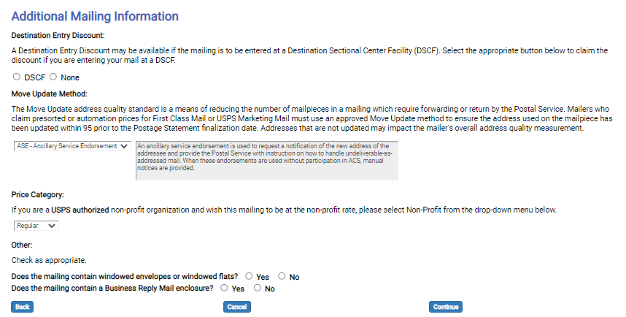
Additional Mailing Options and Return Address
®
Step 5
Additional Mailing Options
Destination Entry Discount – DSCF or None
Move Update Method:
Select method used to meet the Move Update requirement
Price Category – Regular or Nonprofit
Does the mailing contain windowed envelopes or windowed flats? Yes or No
Does the Mailing contain a Business Reply Mail enclosure? Yes or No
Click Continue to proceed.
Notes:
Destination Entry Discount – You MUST indicate if you are entering your mailing at a DSCF location (if unsure ask a BMEU clerk) or else select None.
Move Update Method – You MUST indicate how you are meeting the Move Update requirement for this mailing. (what USPS approved method has the mailer used within the last 95 days to make sure their address list is up to date?)
The Move Update address quality standard is a means of reducing the number of mailpieces in a mailing that require forwarding or return by the Postal Service. Mailers who claim presorted or automation prices for First-Class Mail or USPS Marketing Mail must use an approved Move Update method to ensure the address used on the mailpiece has been updated within 95 days prior to the Postage Statement finalization date. Addresses that are not updated may impact the mailer's overall address quality measurement. This could result in a Move Update assessment.
Price Category - USPS Marketing Mail users must select either Regular or Nonprofit (must have a USPS Nonprofit Authorization # linked to their CRID).
Mailing contains windowed envelopes or windowed flats? - You must check the box if the mailing contains windowed envelopes or windowed flats.
Mailing contains Business Reply Mail enclosure? - You must check the box if the mailing contains a Business Reply Mail enclosure.
Click on Continue to proceed.

Slide 13
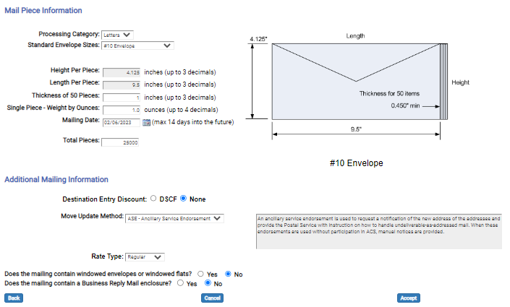
Review and Confirm Job Selections
®
Step 6 Review and Confirm Job Selections
Review all previous selections, making revisions if necessary, and click Accept to continue creating the job.
Click Accept to proceed.
Notes:
This screen will allow you to review and confirm job selections.
After the selections are reviewed, users must click “Accept” to continue.
You can also click “Back” to go back and make changes. Clicking “Cancel” will cancel this job creation.

Slide 14
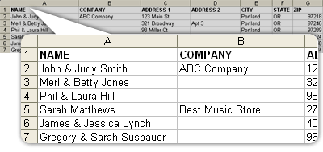
Address List - Excel File
®
You must maintain an address database for mailings.
This database may have to be formatted for use in the IMsb tool.
The file must be in one of the following file formats:
Microsoft Excel 2003 or later versions
Comma Separated Value (CSV)
Notes:
The database used to create the mailings is created by you and uploaded to the tool. If the database (address list/file) is not formatted correctly, the IMsb Tool will not proceed and error messages will appear.
You must submit your address list/database in one of the following formats:
Microsoft Excel 2003 or later versions
Comma Separated Value (CSV)

Slide 15
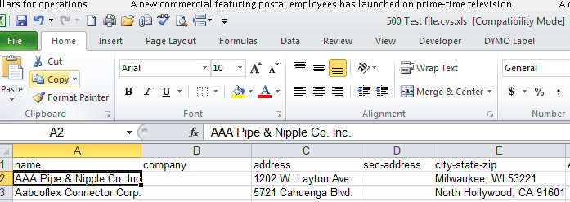
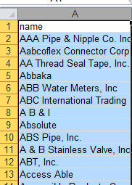
Address List/File Format
®
Excel Address file
Columns
Header Row
Row 1 is always the Header row
Notes:
This is an example of an Address List file in Excel.
The file must contain a Header Row. The top (header) row of the file must include specific column headings as described in the IMsb Tool User Guide.
If the headers or columns are not formatted correctly, you will receive an error and not be able to process your mailing.
REQUIRED FIELDS
Name
Address
City, State, and ZIP (separate or combined)
The header row may have the following optional columns:
First Name
Last Name
Company
(Secondary) sec-address
Urbanization
Please refer to the User Guide for additional acceptable column headings.
If you have multiple tabs (sheets) within your file, the IMsb Tool will only utilize the first tab.
Once the list/file is formatted correctly, you will upload the file into the IMsb tool.

Slide 16
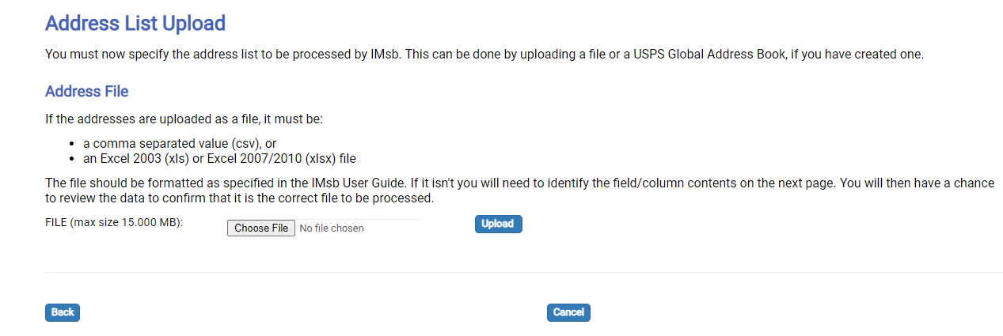
Upload Address File
®
Step 7 – Upload Address File
Upload Address List (Excel or CSV file)
Notes:
An address list must be uploaded. The file should be formatted as specified in the IMsb User Guide. If it isn’t, you will need to identify the field/column contents on the next page. You will then have a chance to review the data to confirm that it is the correct file to be processed.
Select Browse and locate the address list file on your computer.
Select the file so it appears in the FILE: box and click Upload.

Slide 17
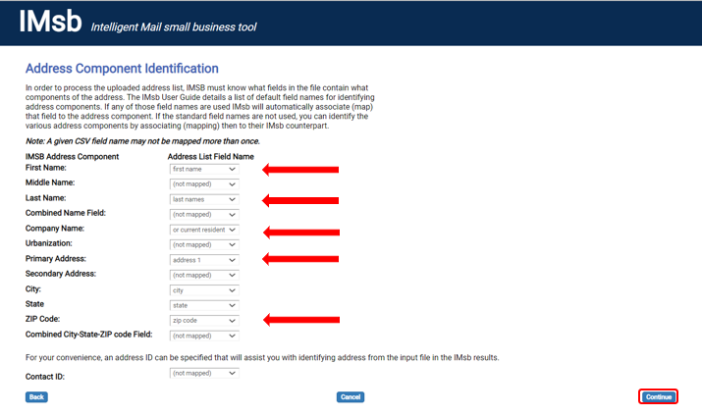
Address Component Identification
®
Step 8 Address Component Identification
Select the field that you wish to be mapped to the required IMsb address component from the drop-down list.
Notes:
Address Component Identification has replaced Address File Mapping from the previous version: In order to process the uploaded address list, IMSB must know what fields in the file contain what components of the address. If the IMsb Tool can’t match an address component field with a column from your data file automatically, you will need to map them manually. Use the dropdowns to select the proper database column for each field.
The components of an IMsb Tool address block are listed (each is a line item of the address). Your address list Column headings from your data file are listed in the dropdowns. The IMsb Tool searches for the column that matches each element.
In general, for the IMsb Tool to create proper addresses you will need to have at minimum:
1) First Name & Last Name or Combined Field Name
2) Primary Address
3) City, State, & ZIP Code or Combined City-State-ZIP Code Field
Review the selections and click on *Continue to process your address file.

Slide 18
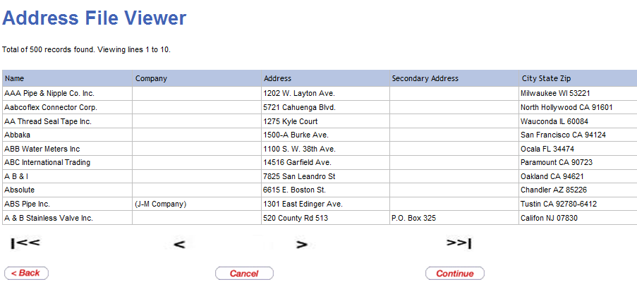
Address File Viewer
®
The Address File Viewer lets you review your file to ensure it’s the correct file.
Notes:
Once the file is uploaded and the fields are mapped, the addresses are processed and the Address File Viewer appears.
You can determine if the list/file is formatted correctly. You want update information in each column to make sure the matching is correct.
After confirming that the file is mapped correctly, click Continue to proceed.

Slide 19
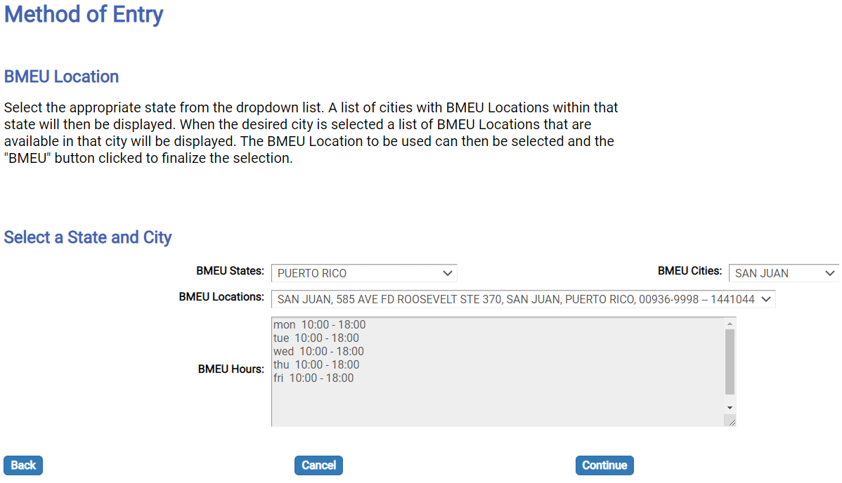
Method of Entry
®
The BMEU location is prepopulated using the permit location finance number.
The IMsb Tool allows you to select other locations if you participate in the USPS Mail Anywhere program.
Step 9 Method of Entry
Notes:
The Method of Entry BMEU Location is prepopulated by using the finance number where the permit is held. If you are approved by USPS to use Mail Anywhere, you may enter mailings at offices other than where your permit is held. You can make that selection here.
Review the selections and click Continue to proceed.

Slide 20
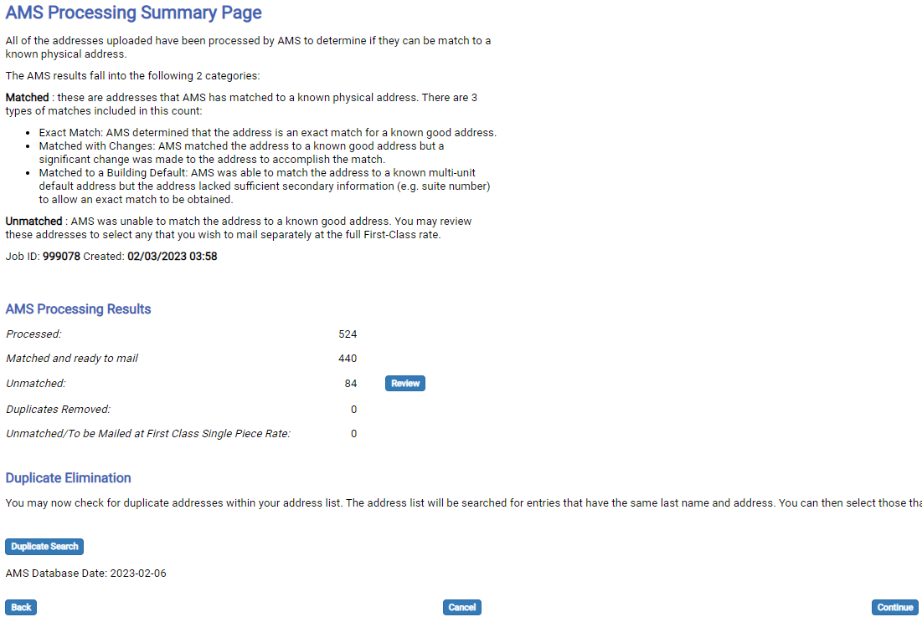
Address Processing
®
Step 10 Address Validation Results
Processed – total addresses in list.
Matched and ready to mail – these are the addresses that AMS has matched to a known physical address.
Unmatched – AMS was unable to match the address to a known good address. You may review these addresses to select any that you wish to mail separately at the full First-Class rate.
Notes:
The Tool now has validated the addresses in the list. This validates that the address is an active delivery address; however, it does not validate the resident for that address. The results of the Address Management System (AMS) processing are returned.
The AMS results fall into the following 2 categories: Matched : these are the addresses that AMS has matched to a known physical address (which is a postal address, we know that some physical addresses are not postal addresses). There are 3 types of matches included in this count:
Exact Match: AMS determined that the address is an exact match for a known good address.
Matched with Changes: AMS matched the address to a known good address, but a significant change was made to the address to accomplish the match.
Matched to a Building Default: AMS was able to match the address to a known multi-unit default address, but the address lacked sufficient secondary information (e.g., suite number) to allow an exact match to be obtained.
Unmatched : AMS was unable to match the address to a known good address. You may review these addresses to select any that you wish to mail separately at the full First-Class rate.
Click *Continue to proceed.
Duplicate Elimination is Optional – You have the option to check for duplicate addresses within your address list. The address list will be searched for entries that have the same last name and address. You can then select those that you wish to be removed from the output address list. Let’s look at this closer on the next slide.

Slide 21
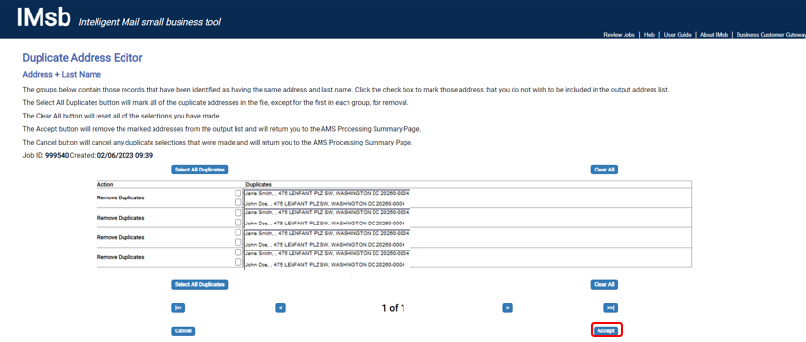
Duplicate Elimination
®
Allows duplicates to be removed within a file.
Notes:
IMsb Tool allows the option for duplicates to be removed by clicking Duplicate Search. This will identify duplicates by Address and Last Name.
To remove all the identified duplicates at once, click the Select All Duplicates button or select individually. (This will delete all duplicates leaving only the original address in the list.)
Click on Accept to accept all duplicate deletions.
Click Continue to proceed.

Slide 22
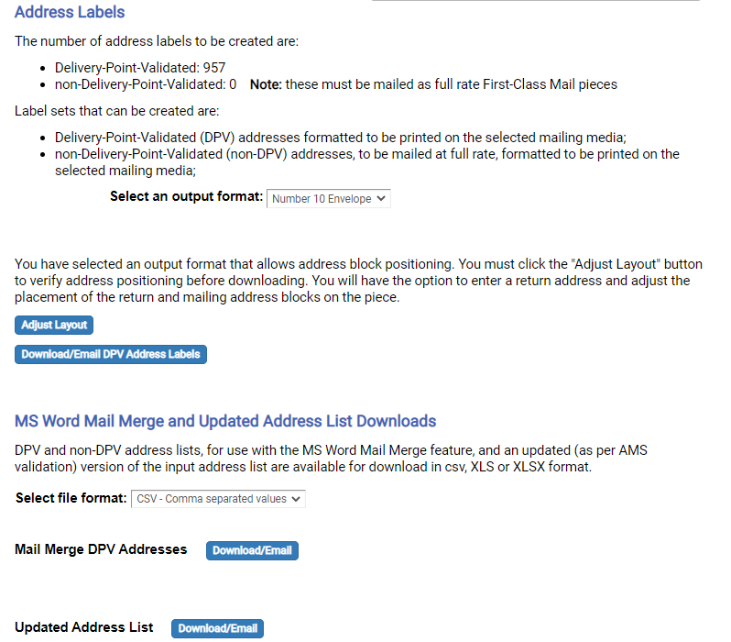
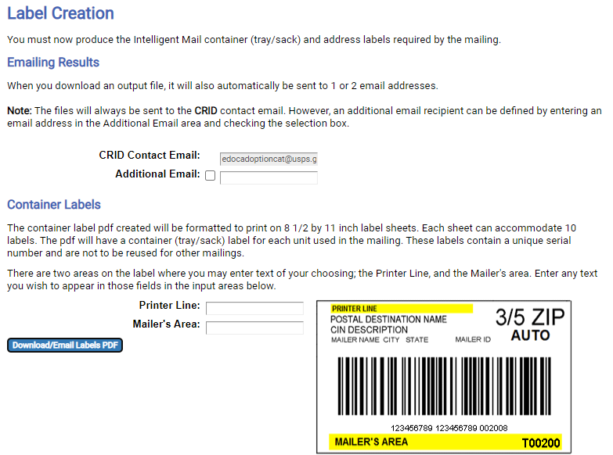
Creating Unique Intelligent Mail Tray/Sack Labels
®
Step 11 Create Labels
2
1
Notes:
Now you must produce the Intelligent Mail container (tray/sack) and address labels required by the mailing.
The CRID Contact email is already listed. You can add an additional email that you wish the files be emailed to.
Container Label Creation
(Optional) You may enter information on the Printer Line (e.g., June 2021 Newsletter) and Mailer’s Area (e.g., Joe’s Mailing Services) to be printed on the tray label (highlighted in yellow).
Click “Download/Email Labels PDF” to generate a PDF file of the tray/sack labels. You will receive a popup that allows the file to be viewed as well as an email with the same file.
Address Label Creation
Select an output format – When you select an output format that allows address block positioning (Number 10 Envelope or Letter Insert) it gives you the option to verify the address positioning before downloading by clicking on “Adjust Layout.” Here, you will also have the option to enter a return address and adjust the placement of the return and mailing address blocks on the piece. If you select the output format of 1 or 1.33-inch label you will see a message indicating that these labels are not large enough to include the ASE. Therefore, the ASE must be preprinted on the mailpiece that the labels are to be attached to.
Click the “Download/Email DPV Address Labels” button
MS Word Mail Merge
Select File format.
For Mail Merge, under Mail Merge DPV Addresses, click the “Download/Email” button.
4. Updated Address List Downloads
For Updated Address List, click the “Download/Email” button.
You must download or email the container labels and either the address labels or mail merge file to continue.

Slide 23
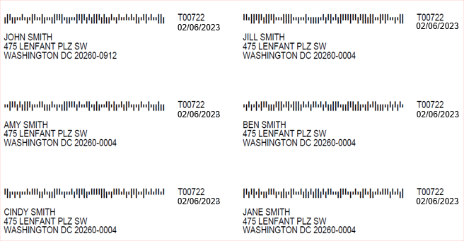
Example of Address Labels Generated by Tool
®
Notes:
Here is an example of the 1” x 4“ label generated by the tool. The tray number that this piece belongs to is notated next to the barcode along with the date the address list was processed through AMS.
Note - The address label barcodes are unique and can only be used for the job being created. Labels cannot be reused.
Recommended best practice: To avoid time out or connectivity issues while using the IMsb Tool, open and save the PDF file to your computer or access the file emailed to you. You should print the address labels only after the successful upload of the mailing job to PostalOne!.
Important – Only use Adobe Acrobat Reader to print the labels. Using any other program to open and print the PDF files may render the barcodes unreadable by USPS mail processing equipment.

Slide 24
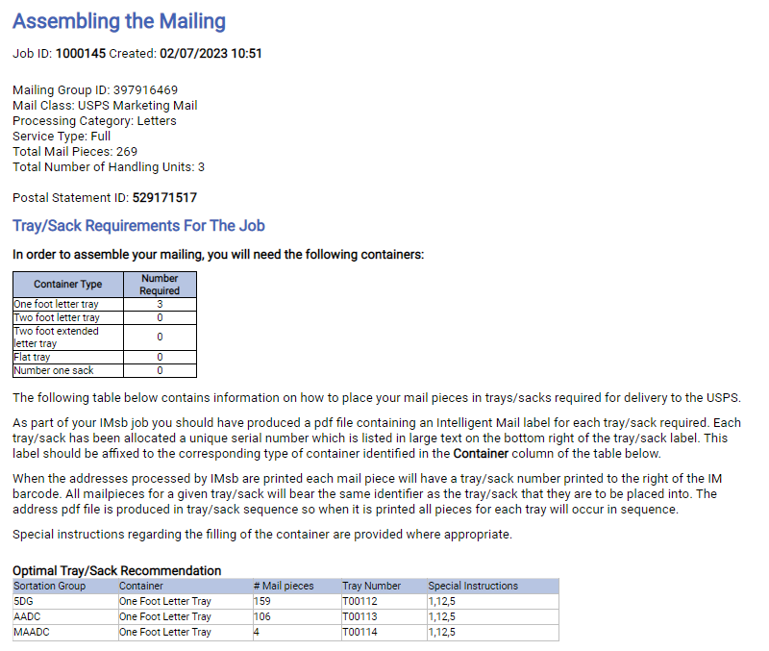
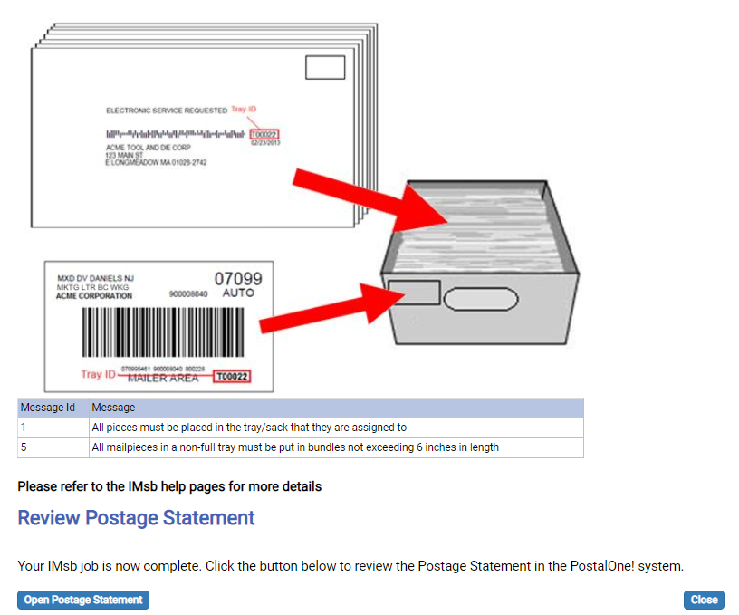
Assembling the Mailing
®
Clicking on Open Postage Statement starts the electronic submission of the postage statement and qualification report.
Notes:
The Assembling the Mailing screen shows you which pieces belong in which tray (or bundle & sack for flats) along with other appropriate mail preparation instructions. The pieces do not need to stay in order, they just go in their correct bundle, tray, and sack.
Review the Tray/Sack Requirements for the Job along with any Messages and click Open Postage Statement to proceed with the job submission.

Slide 25
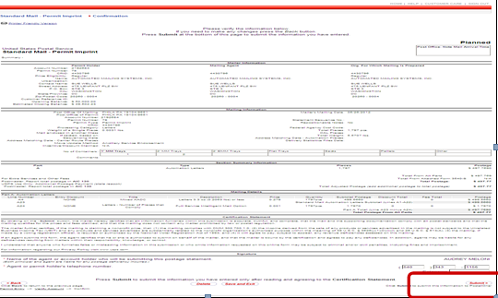
Planned Postage Statement – Review and Submit
®
Step 13 Create and Submit Electronic Postage Statement
Notes:
Almost done!! Finally, review the “Planned” postage statement. This is the last opportunity to see if everything is correct. Scroll down and click the Submit button to submit the job to PostalOne!.
Once you get to this screen, if the system times out, you can access and submit this job from the “View incomplete forms I have started” link on the Postal Wizard page.

Slide 26
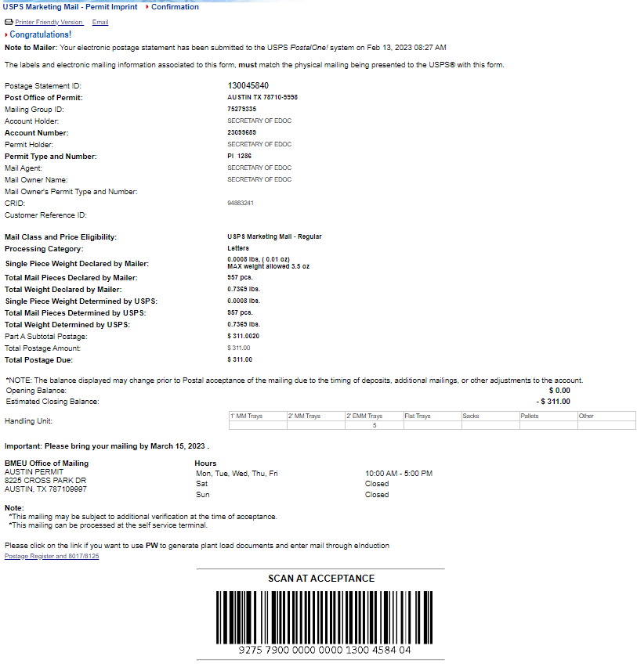
Bring Mailing to Acceptance Unit
®
Insert bmeu ecan
Step 14 Print the Electronic Confirmation Acceptance Notice
Print Electronic Confirmation Acceptance Notice page
You are ready to bring the mailing to the acceptance unit (BMEU).
Notes:
Success! Congratulations – the mailing has been successfully submitted electronically and you can now print this Electronic Confirmation Acceptance Notice.
The location, address, and hours of acceptance for the BMEU are provided on the confirmation sheet. Next, print your piece IMbs and container IMbs and assemble your mailing.
Bring the Electronic Confirmation Acceptance notice and the completed mailing to the acceptance unit (BMEU). You are not charged postage until the mailing is physically presented at the BMEU and finalized or on the mailing date indicated if you are a Seamless mailer. NOTE – The printer friendly version may create 2 pages. The Scan Acceptance barcode would be needed for SST scanning.

Slide 27
Mailing Appears on Dashboard – UPD Status
®
Once the postage statement has been submitted, it will appear on the mailer’s Dashboard with Statement Status – UPD (USPS Processing Due).
Mailers may cancel jobs from their Dashboard if the BMEU has not yet checked-in the job. Check-in occurs upon presentation of the mailing at the BMEU.
The mailer’s dashboard mirrors the USPS dashboard.
Notes:
Once you have submitted the job, it will appear on the PostalOne! Dashboard.
The Dashboard can be accessed from the Business Customer Gateway Mailing Services page, from the Postal Wizard page, or saved as a Favorite Services short cut. It is now visible to the USPS at the BME entry location indicated in the mailing.
The Dashboard allows users to manage and view the status of their jobs. If you needed to cancel a job, this is where you would go – click cancel and it will be cancelled.

Slide 28
Resources – Business Customer Gateway ®
®
Contact your local BMEU manager for additional information.
You can access the current IMsb User Guide located on the right-hand side on the IMsb Tool landing page.
IMsb Tool page at PostalPro : Intelligent Mail® for Small Business Mailers (IMsb) | PostalPro
The User Guide can also be found on IMsb Tool page at PostalPro.
Intelligent Mail for Small Business Owners (IMsb) User Guide | PostalPro (usps.com)
Mailing & Shipping Solutions Center (MSSC) Phone: 1-877-672-0007 Email: MSSC@usps.gov
Business Postage Price Calculator (usps.com)
Notes:
User Guide https://postalpro.usps.com/mailing/imsb-guide is very descriptive and has FAQ section.
For assistance, contact the Mailing & Shipping Solutions Center (MSSC) Phone: 1-877-672-0007 Email: MSSC@usps.gov

Slide 29
®
Questions?
Notes:
Any questions? We can now go into the Business Customer Gateway and do a live demo.

